Slide 1
The Need for Design Principles - Refactoring
Lecture 04

Slide 2
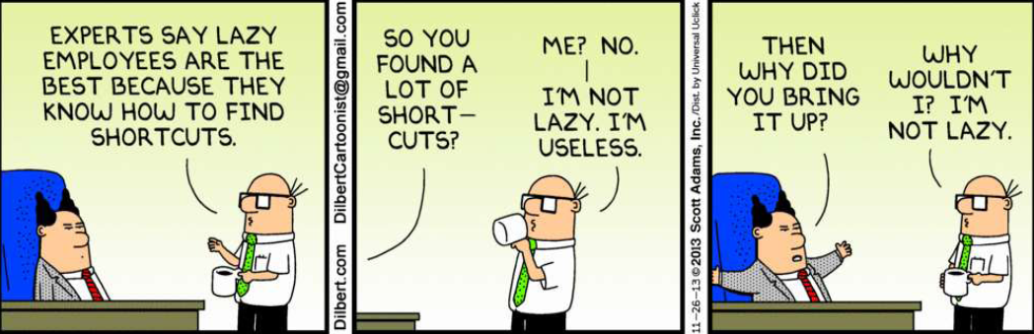
Can you understand it?

Slide 3
Software Rots
When the requirements change, the system must change often in ways not anticipated by the initial design. Over time the software begins to acquire design smells... The software rots!
The design should be kept as clean, simple, and as expressive as possible
Never say, we'll do that later
...because you won't!
When a requirement changes, the design should be updated to be resilient to that kind of change in the future.

Slide 4
Refactoring
How to modify design and code to prevent rot?
Refactoring
...the process of changing a software system in such a way that it does not alter the external behavior of the code yet improves its internal structure.
You can refactor code & design.

Slide 5
Single-Responsibility Principle (SRP)
A class should have only one responsibility.
OR
A class should have only one reason to change.
A class with several responsibilities creates unnecessary couplings between those responsibilities

Slide 6
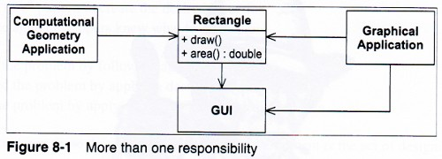
e.g. Rectangle Class
The Geometry Application is concerned with the mathematics of geometric shapes
The Graphical Application may also involve some geometry, but it also needs to draw geometric shapes
The Rectangle class has two responsibilities:
Provide a mathematical model of a rectangle Render a rectangle

Slide 7
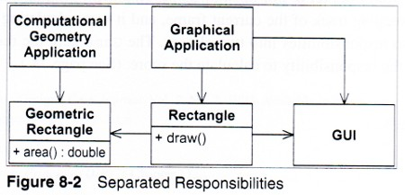
e.g. Rectangle Class
Problems created:
Inclusion: The GUI must be included in the Geometry Application
A change required for one application may affect the other (e.g. adding a color attribute)
Solution:
Separate the two responsibilities (math rep. + drawing) into two separate classes

Slide 8
Ex.2 SRP – Employee Class
public class Employee{
private String employeeId;
private String name;
private string address;
private Date dateOfJoining;
public boolean isPromotionDueThisYear(){
//promotion logic implementation
}
public Double calcIncomeTaxForCurrentYear(){
//income tax logic implementation
}
//Getters & Setters for all the private attributes
}
The Employee class looks logically correct. It has all the employee attributes like employeeId, name, age, address & dateOfJoining. It even tells you if the employee is eligible for promotion this year and calculates the income tax he has to pay for the year.
However, Employee class breaks the Single Responsibility Principle. Lets see how

Slide 9
Ex.2 SRP – Employee Class
The logic of determining whether the employee is due this year is actually not a responsibility which the employee owns. - HR department owns this responsibility.
Similarly, income tax calculation is not a responsibility of the Employee. - finance department’s responsibility
Lastly, Employee class should have the single responsibility of maintaining core attributes of an employee.
Notes:
The logic of determining whether the employee is due this year is actually not a responsibility which the employee owns. The company’s HR department owns this responsibility based on the company’s HR policies which may change every few years. On any such change in HR policies, the Employee class will need to be updated as it is currently has the responsibility of promotion determination.
Similarly, income tax calculation is not a responsibility of the Employee. It is the finance department’s responsibility which it takes care of the current tax structure which may get updated every year. If Employee class owns the income tax calculation responsibility then whenever tax structure/calculations change Employee class will need to be changed.
Lastly, Employee class should have the single responsibility of maintaining core attributes of an employee.

Slide 10
Ex.2 SRP – Employee Class
Solution
HRPromotions.java
public class HRPromotions{
public boolean isPromotionDueThisYear(Employee emp){
//promotion logic implementation using the employee info. passed
}
}
FinITCalculations.java
public class FinITCalculations{
public Double calcIncomeTaxForCurrentYear(Employee emp){
//income tax logic implementation using the employee info. passed
}
}
Employee.java adhering to Single Responsibility Principle
public class Employee{
private String employeeId;
private String name;
private string address;
private Date dateOfJoining;
//Getters & Setters for all the private attributes
}

Slide 11
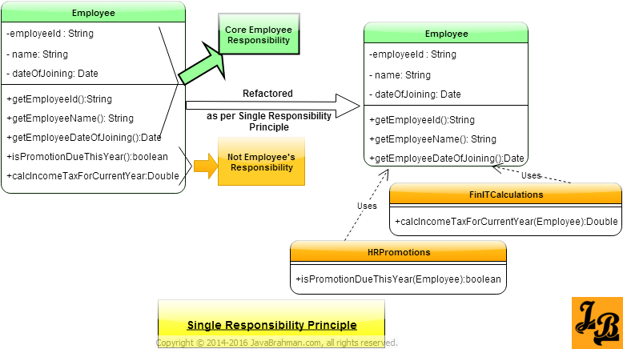
SRP based refactoring

Slide 12
Design Tip of the Day
Meaningful Names in Design and Implementation
Quicker to Comprehend
Easier to Remember
Maintainable Code
Clear Intent

Slide 13
Symptoms of Poor Design
Rigidity
The design is hard to change
Fragility
The design is easy to break
Immobility
The design is hard to reuse
Viscosity
It is hard to do right thing
Needless Complexity
Overdesign
Needless Repetition
Copy paste code
Opacity
Disorganized expressions

Slide 14
Rigidity
The system is hard to change because every change forces many other changes to other part of the system
Single change causes cascade of subsequent changes in dependent modules
The more modules must be changed the more rigid the design
Comes from High coupling and Low Cohesion
Telltale sign: "Huh, it was a lot more complicated than I thought."
Examples
Status fields – New status values
Dependency on concrete classes

Slide 15
Fragility
The tendency of a program to break in many places when a single change is made
Code breaks in unexpected places that have no conceptual relationship with the changed area
On every fix the software breaks in unexpected ways
Fixing the problems causes new problems
Examples
Dependency on concrete classes
No edge cases or bound checks

Slide 16
Fragility of the design
Eaxmple: Kids play with a deck of cards to build a house of cards. When it comes about 3-4 feet you very careful to put stuff on it. And you say don't open the door. You are very quiet and move very slowly. And we grow and create software. We type the code it compiles, we move slowly from the computer, and we say “The code works don't touch it, I'm going home! ShipIt!”
Telltale signs:
Some modules are constantly on the bug list
Time is used finding bugs, not fixing them
Programmers are reluctant to change anything in the code

Slide 17
Immobility
It is hard to separate the system into components that can be reused in other systems because risk involved separating parts from original system is too much
The useful modules have too many dependencies
The cost of rewriting is less compared to the risk to separate those parts
Telltale sign: A module could be reused but the effort and risk of separating it from the original environment is too high
Examples
Too many constants
Too many global variables
Too much coupling

Slide 18
Viscosity
Doing things right is harder than doing things wrong
When the design preserving methods are more difficult to use than the hacks, the viscosity of the design is high – the hack is cheaper to implement than the solution within the design
When the development environment is slow and inefficient, developers will be tempted to do wrong things
-> Unit Testing will help!
Examples
Use of public member fields
Insufficient documentation of the implemented classes
Highly complex design
Low performing code

Slide 19
Needless Complexity
Overdesign! Design contains infrastructure that adds no direct benefit
Design becomes littered with constructs that are never used
Makes software complex and difficult to understand
Job security! Nobody can understand except me ☺
“Simple things should be simple and complex things should be possible” - Alan Kay
Examples
Too much generic code
Make use of middle men
Long hierarchy of interfaces and classes

Slide 20
Needless Repetition
The design contains repeating structures that could be unified under a single abstraction
Problem is due to developer’s abuse of cut and paste
It is really hard to maintain and understand the system with duplicate code
Examples
Bad Algorithms
Make use of switch statements
Duplicate code in different classes
Avoiding abstraction – copying the existing code and tweak according to the requirements

Slide 21
Opacity
Very difficult to understand code on what it does.
It does not express its purpose well
The boss says don't touch that code the guy who wrote it is no longer works here!
Telltale sign: You are reluctant to fix somebody else’s code or even your own!
Example
Too much commented code
Incorrect naming convention
Not well indented code
Algorithm written in a complex manner

Slide 22
Signs of Good Design
Adaptability
The design is easy to change
Robustness
The design is hard to break
Reusability
The design can be reused
Fluidity
It is easy to do the right thing
Simplicity
The design is the “simplest thing that will work”
Terseness
No unneeded duplication of code
Perspicuity
Organized and clear

